Slide 1
Prompt-Based Learning
Most slides are from Umass CS685 Spring 2023 Advanced Natural Language Processing
Slides are adopted from Advanced NLP course at UMass.

Slide 2
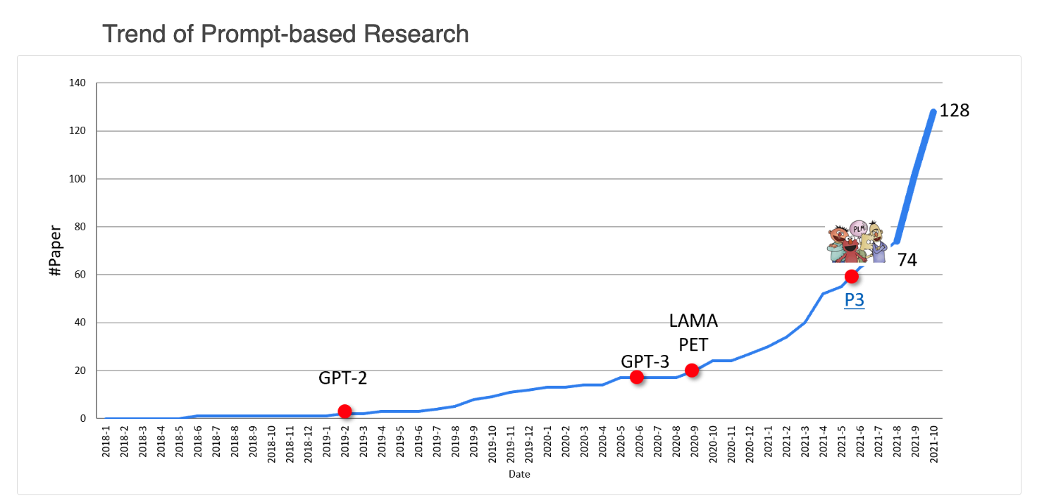
Trend (before 2022)

Slide 3
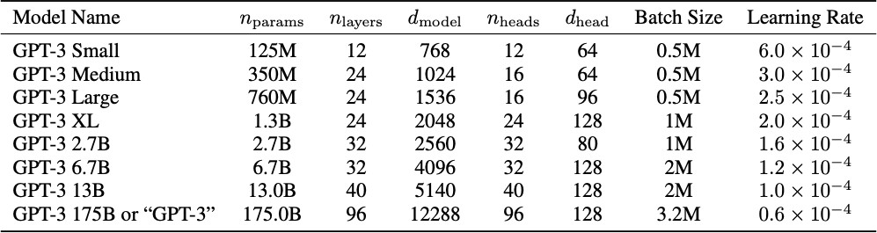
The language model “scaling wars”!
ELMo: 93M params, 2-layer biLSTM
BERT-base: 110M params, 12-layer Transformer BERT-large: 340M params, 24-layer Transformer

Slide 4
The language model “scaling wars”!
ELMo: 93M params, 2-layer biLSTM
BERT-base: 110M params, 12-layer Transformer BERT-large: 340M params, 24-layer Transformer

Slide 5
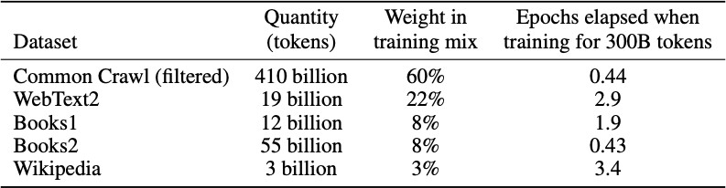
The language model “scaling wars”!
ELMo: 1B training tokens BERT: 3.3B training tokens RoBERTa: ~30B training tokens

Slide 6
2022-2023:
PaLM (Google): 540B params, 118 layers, 18432
d_model, 780 billion training tokens
Model not available
ChatGPT (OpenAI): Params, layers, dimensionality,
training data size unknown
Model available only through blackbox API
LLaMa (Meta): 65B params, 80 layers, 8192 d_model,
1.4 trillion tokens of training data
Model parameters publicly available!
GPT4 (OpenAI): Params, layers, dimensionality,
training data size unknown
Model available only through blackbox API
Bard (Google): Params, layers, dimensionality,
training data size unknown
Model available only through blackbox API

Slide 7
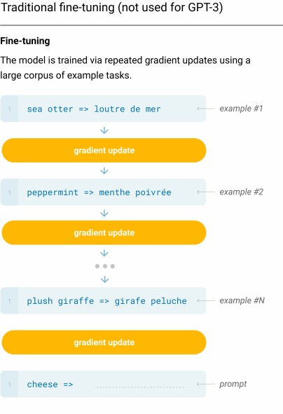

Slide 8
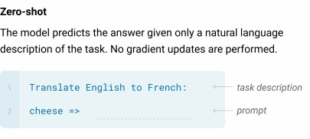

Slide 9
No fine-tuning!!! Literally just take a pretrained LM and give it the following prefix:
“Translate English to French: cheese =>”

Slide 10
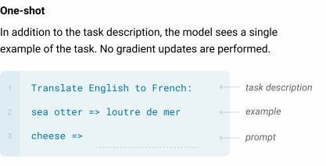
No fine-tuning!!! Literally just take a pretrained LM and give it the following prefix:
“Translate English to French: sea otter => loutre de mer, cheese =>”

Slide 11
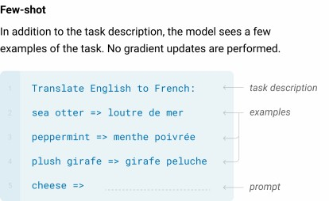
No fine-tuning!!! Literally just take a pretrained LM and give it the following prefix:
“Translate English to French: sea otter => loutre de mer, peppermint => … (few more examples), cheese =>”
Max of 100 examples fed into the prefix in this way

Slide 12
How does this new paradigm compare to “pretrain + finetune”?

Slide 13
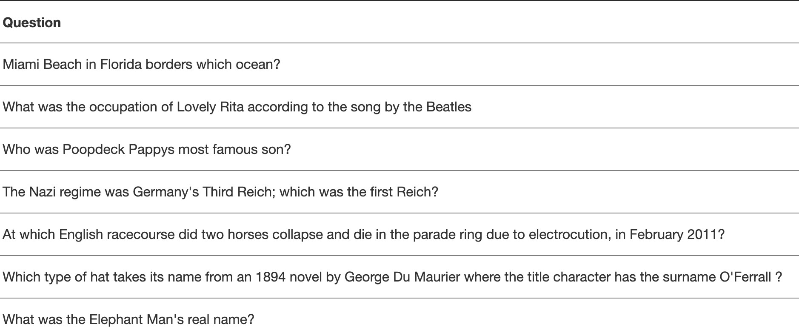
TriviaQA

Slide 14
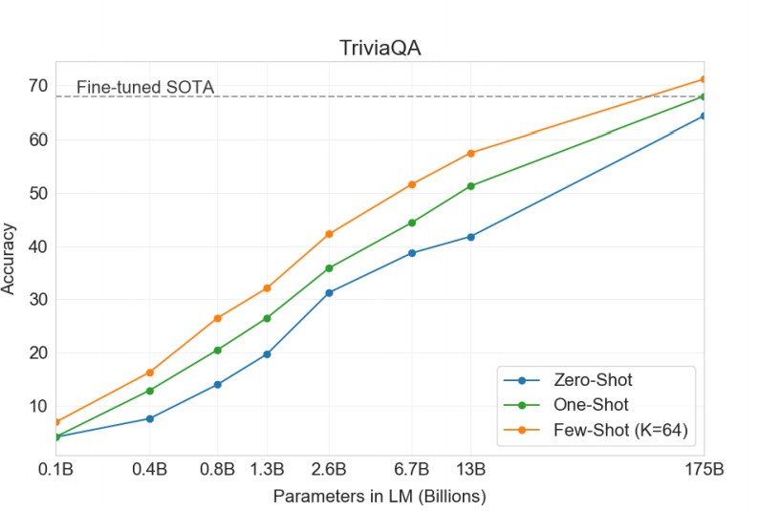

Slide 15
What about translation? (7% of GPT3’s training data is in languages other than English)

Slide 16
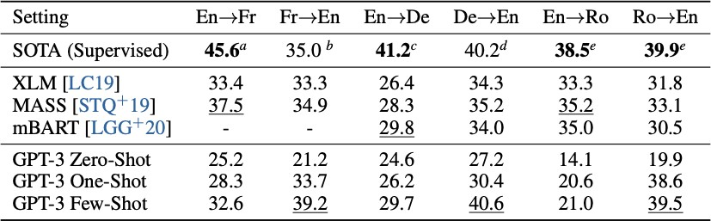

Slide 17
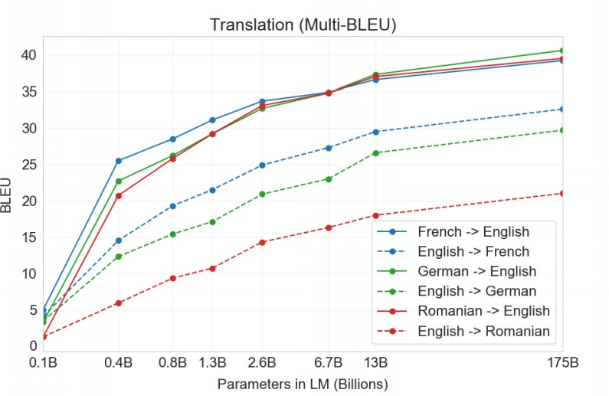
Improvements haven’t plateaued!

Slide 18
What about reading comprehension QA?

Slide 19
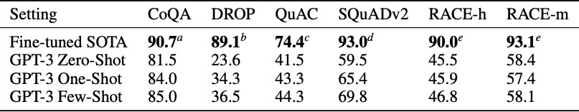
Struggles on “harder” datasets

Slide 20
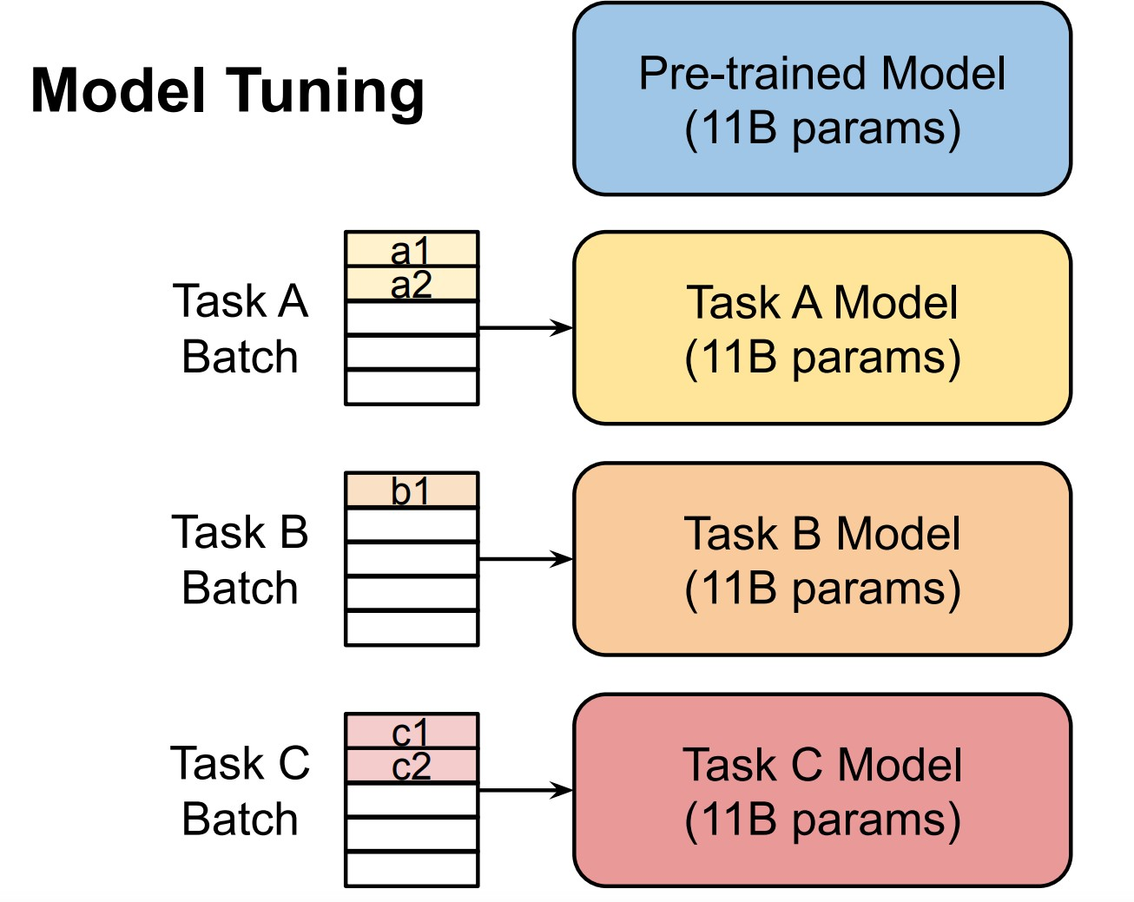
Practical challenges: large-scale models are costly to share and serve
Lester et al., 2021

Slide 21
Discrete/hard prompts
Discrete/hard prompts
  natural language instructions/task descriptions
Used also to fine-tune models using MLM/LM objectives.

Slide 22
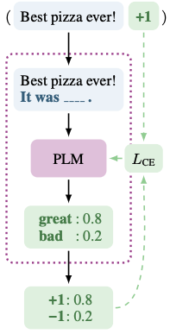
PET

Slide 23
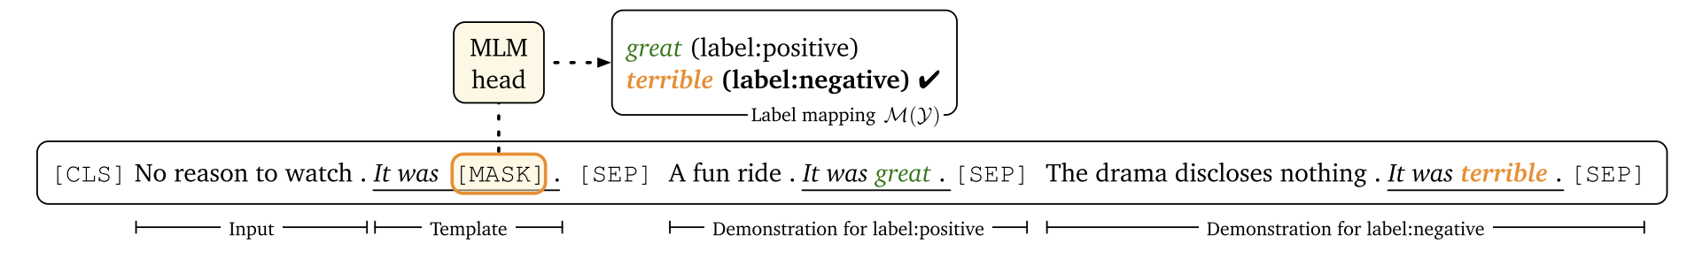
LM-BFF
Prompt-based fine-tuning with demonstrations

Slide 24
Discrete prompts: problems
requiring domain expertise/understanding of the model’s inner workings
performance still lags far behind SOTA model tuning results
sub-optimal and sensitive
prompts that humans consider reasonable is not necessarily effective for language models (Liu et al., 2021)
pre-trained language models are sensitive to the choice of prompts (Zhao et al., 2021)

Slide 25
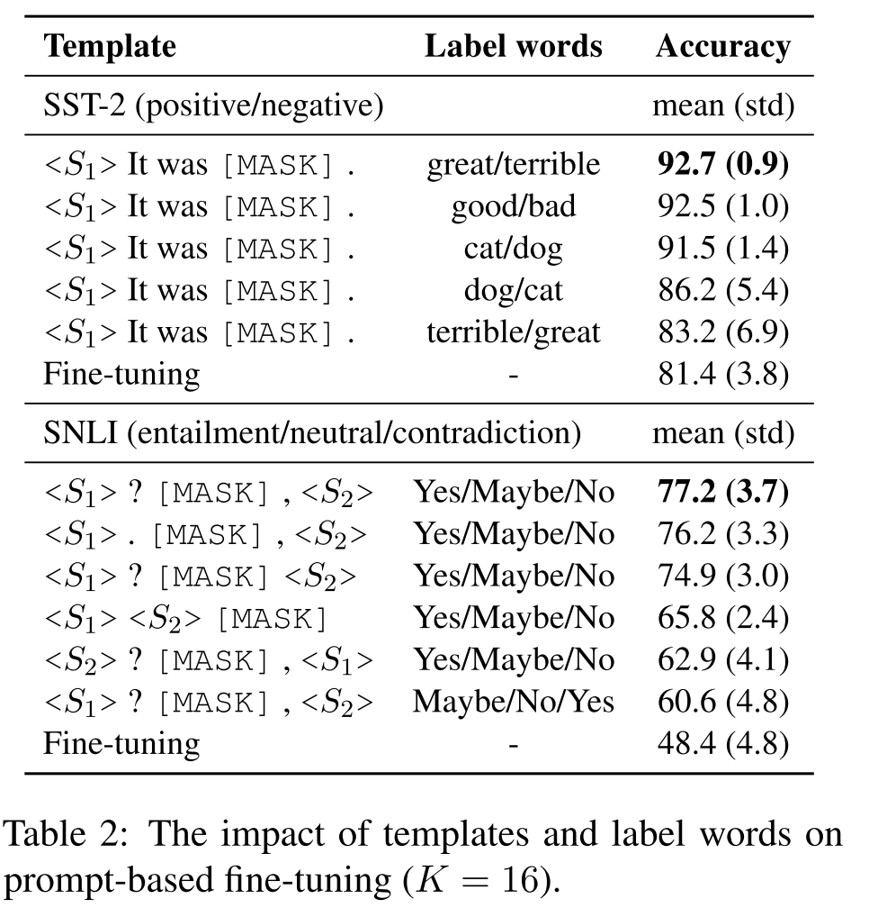
Sub-optimal and sensitive discrete/hard prompts

Slide 26
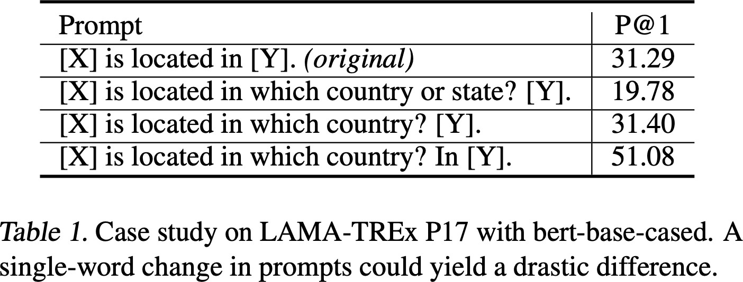
Sub-optimal and sensitive discrete/hard prompts
Liu et al., 2021

Slide 27
Shifting from discrete/hard to continuous/soft prompts
Progress in prompt-based learning
  manual prompt design (Brown et al., 2020; Schick and Schuetze, 2021a,b)
  mining and paraphrasing based methods to automatically augment the prompt sets (Jiang et al., 2020, Abaskohi et al., 2023)
  gradient-based search for improved discrete/hard prompts (Shin et al., 2020)
  automatic prompt generation using a separate generative language model (i.e., T5) (Gao et al., 2020)
  learning continuous/soft prompts (Liu et al., 2021; Li and Liang., 2021; Qin and Eisner., 2021; Lester et al., 2021)
Continuous/soft prompts
  additional learnable parameters injected into the model

Slide 28
It remains unclear how to learn continuous/soft prompts effectively?
P-tuning (Liu et al., 2021): encode dependencies between prompt tokens using a BiLSTM network
P-tuning (Liu et al., 2021), Prefix Tuning (Li and Liang., 2021): inject prompts at different positions of the input / model
P-tuning (Liu et al., 2021): use mixed prompt initialization strategies
Soft Prompts (Qin and Eisner., 2021): use ensemble methods, e.g., mixture-of-experts

Slide 29
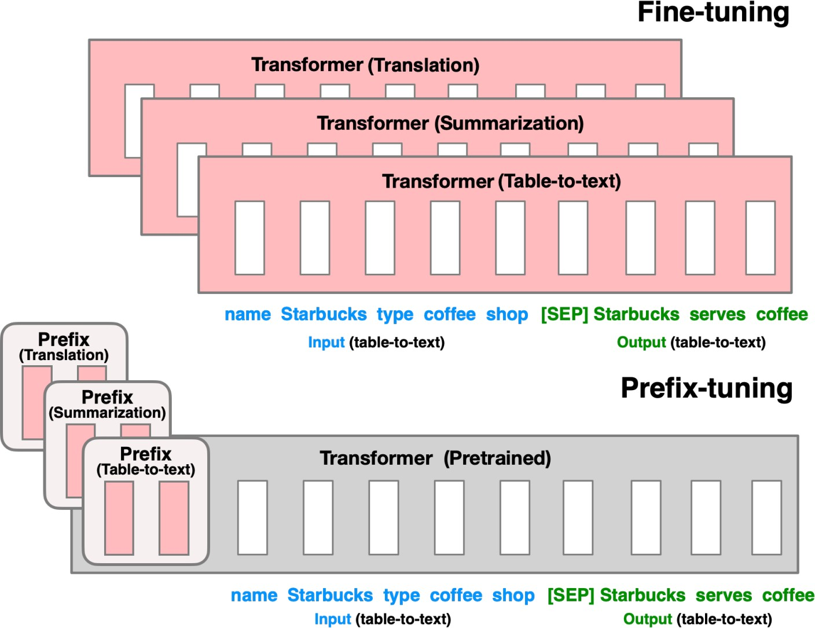
Prefix tuning (Li & Liang, ACL 2021)
Notes:
This method freezes the model parameters and backpropagates the error during tuning to prefix activations prepended to each layer in the encoder stack, including the input layer

Slide 30
Prompt Tuning idea (Lester et al., 2021)
What is a prompt in Prompt Tuning?
  a sequence of additional task-specific tunable tokens prepended to the input text
Notes:
We freeze the entire pre-trained model and only allow an additional k tunable tokens per downstream task to be prepended to the input text.

Slide 31
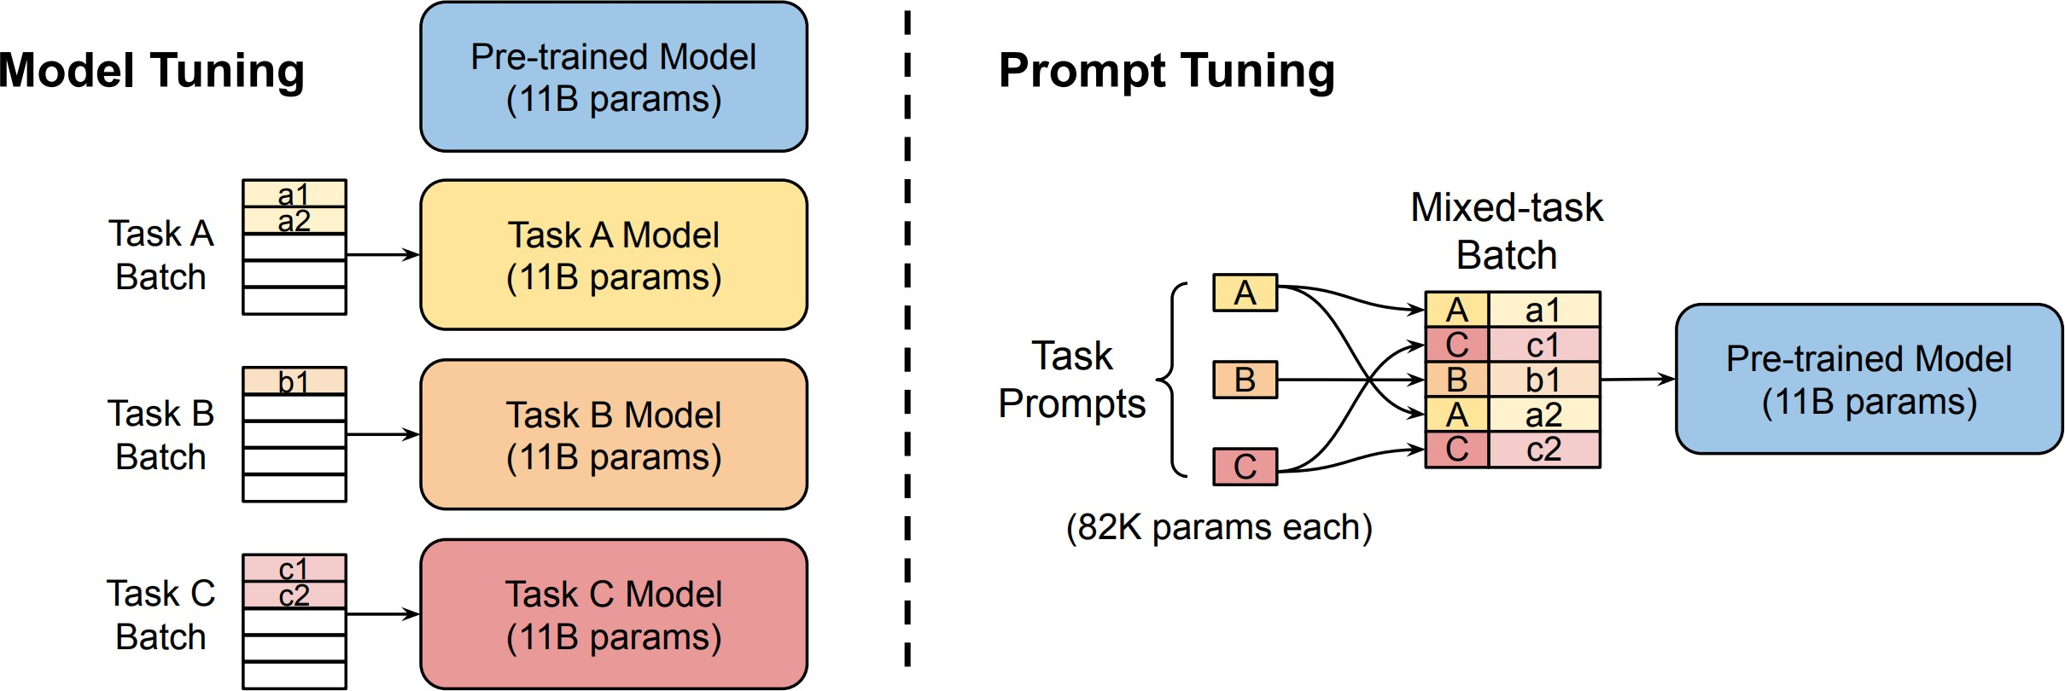
Parameter-efficient Prompt Tuning

Slide 32
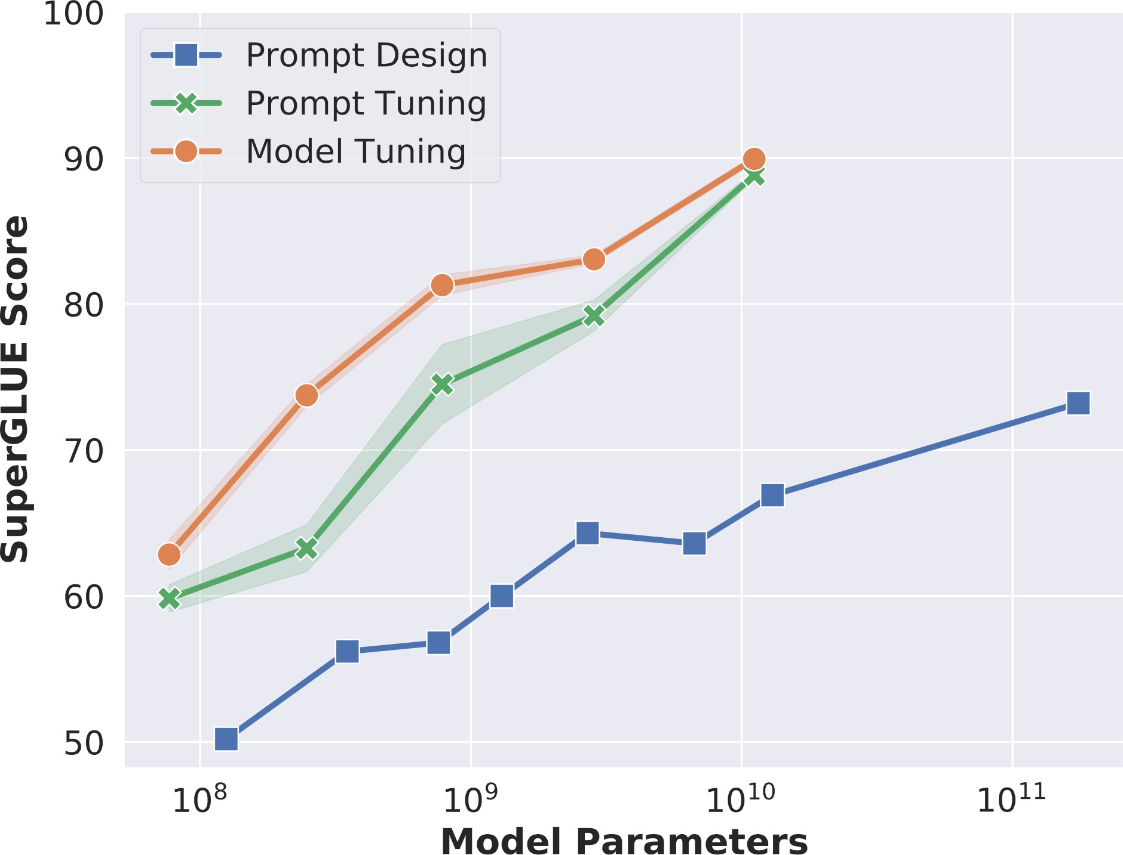
Prompt Tuning becomes more competitive with scale

Slide 33


Room for improving Prompt Tuning
Lester et al., 2021
performance
stability

